Slide 1
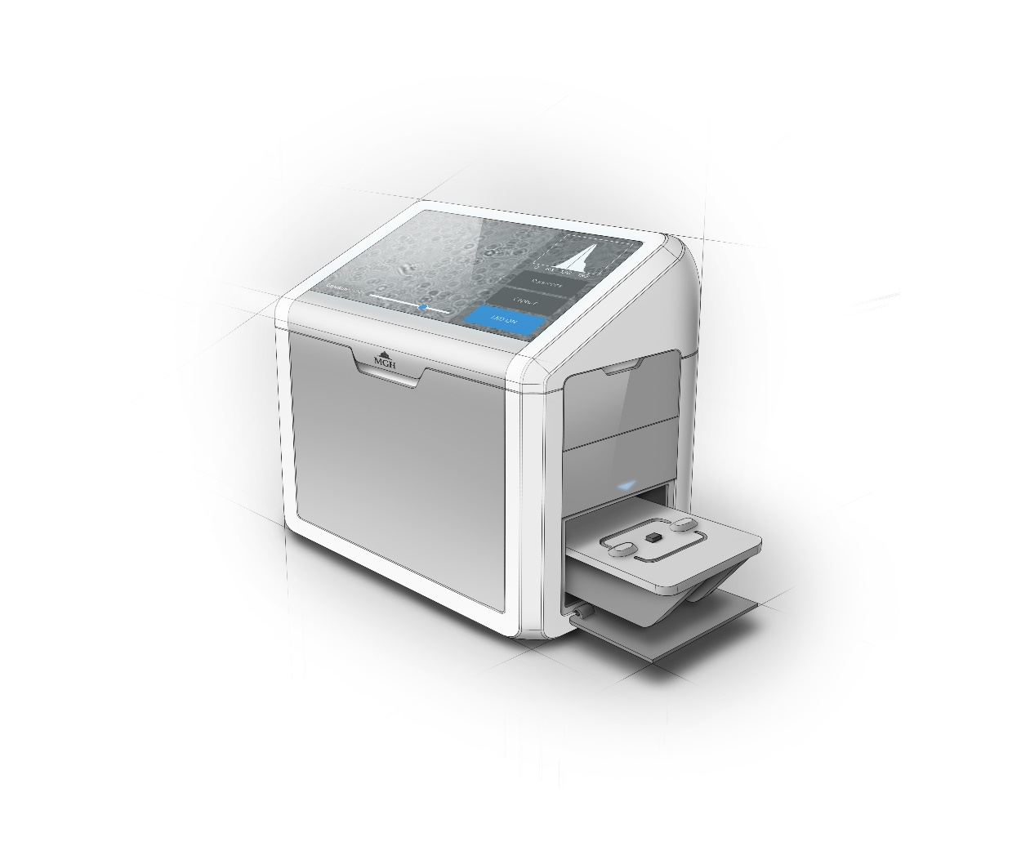
Deep Learning of Optical Diffraction
Ismail Degani
6.874 Final Presentation

Slide 2
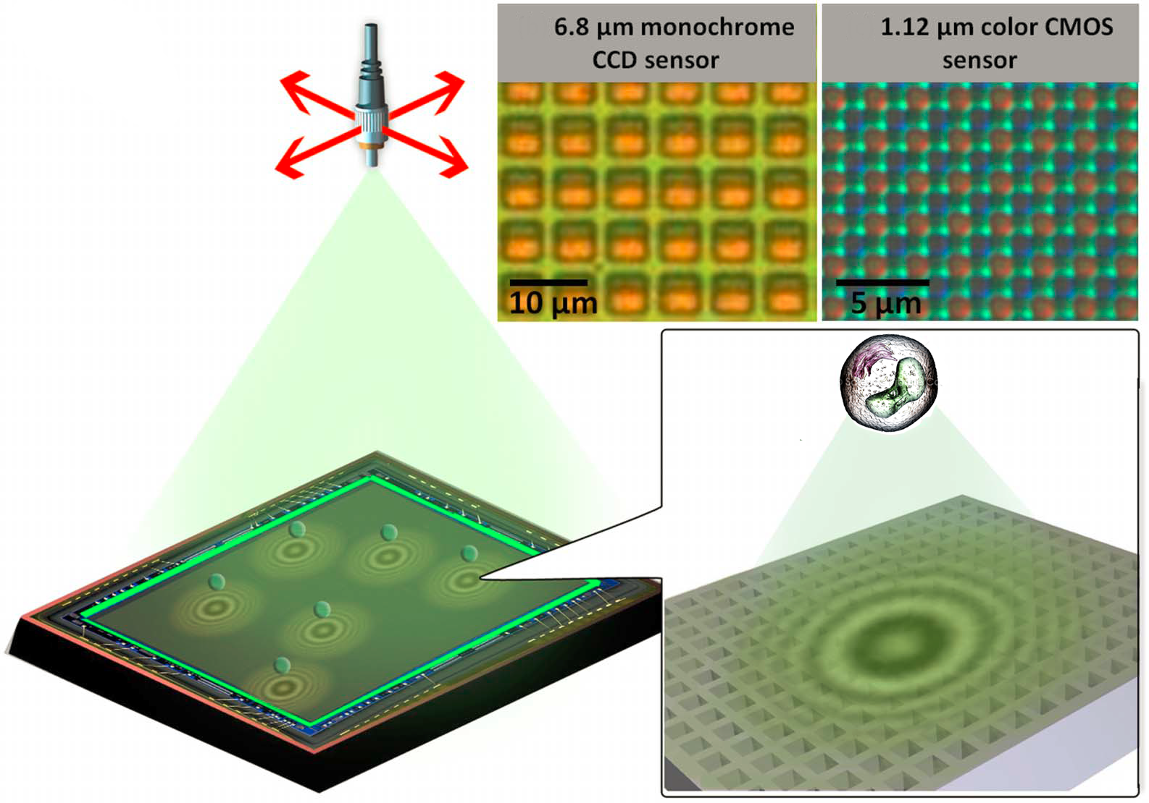
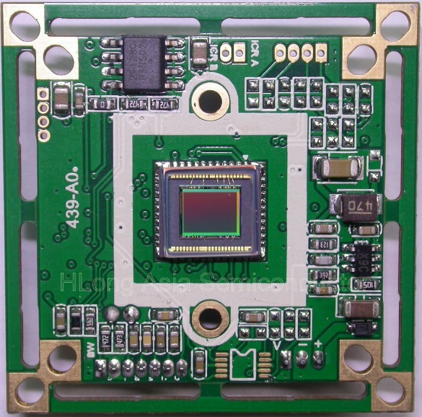
Greenbaum, A., Luo, W., Khademhosseinieh, B., Su, T., Coskun, A. F., & Ozcan, A. (2013). Increased space-bandwidth product in pixel super-resolved lensfree on-chip microscopy. Scientific Reports, 3(1). doi:10.1038/srep01717

Slide 3
Digital Holography: A “Software” Lens

Slide 4
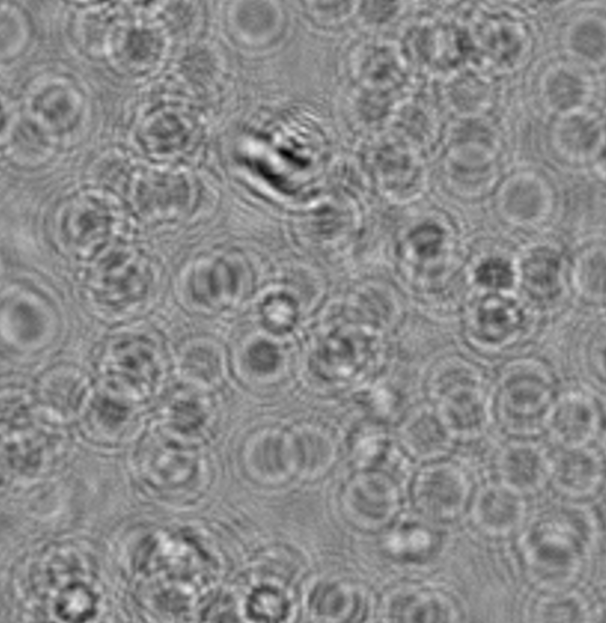
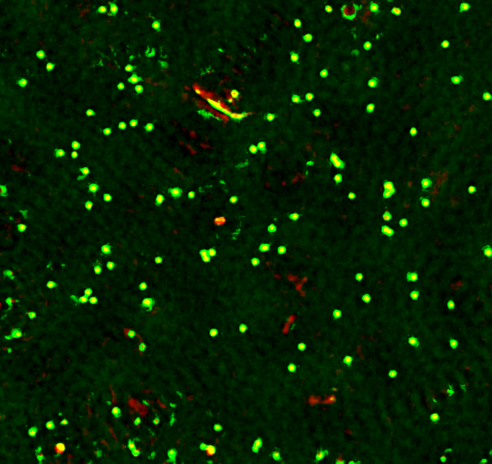
Target Labeled Dataset: B-Cell Lymphoma

Slide 5
Diffraction is well understood

Slide 6

Low Cost
Less calibration

Slide 7
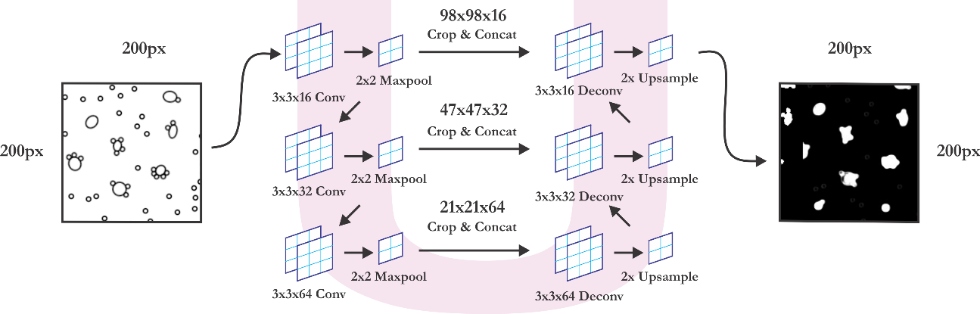
3-Layer U-NET Architecture

Slide 8
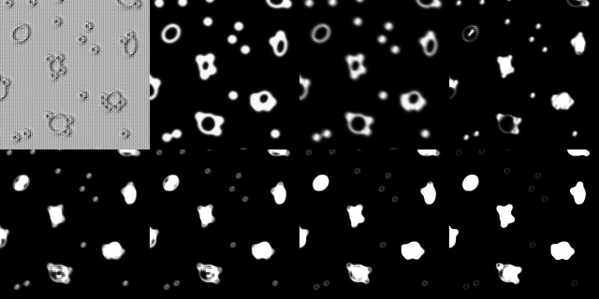
3-Layer U-NET Architecture
Epoch 0 | Epoch 2 | Epoch 4 | Epoch 6
Epoch 8 | Epoch 10 | Epoch 12 | Epoch 14

